Slide 1
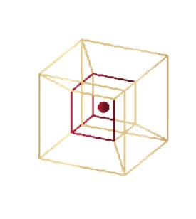

INTERACTIVITY AS THE FUNDAMENTAL HUMAN PHENOMENON
INSTITUTE FOR PHILOSOPHY AND INTERDISCIPLINARY STUDIES, NOVI SAD
IGOR GRUJICIC AND NEBOJSA MAKSIMOVIC

Slide 2
How we perceive
Consciousness never perceives an event or object as isolated, but always within a wider network of meaning, not only through what is currently present and given in experience, but also through what is absent as implicit, expected or imagined.
We observe all things through the form of time, so we have a certain projection, as an expectation of what will happen, and through the form of space we open up the possibility of something appearing that is not currently captured by our immediate attention.
Within our thinking apparatus there are fundamental cognitive patterns that shape our understanding of cause and effect, there are premises within us, our part of the ego-self that thinks, which categorically decides what we will get externally as a result. These premises shape not only the way we interpret causes and effects but also how we emotionally react to external stimuli. By changing this initial base premise in our thinking mechanism, the experience of the environment also changes.
There is no human reality for itself but always in relation, in relation to existence, in interaction with the world

Slide 3
for a person with symptoms of schizophrenia, the world is no longer a shared space of meaning, but an individual hermetic world of specific meanings, which have meaning and symbolism only for that person, while the real (shared) world is meaningless to him. When this happens, there is a loss of contact with others, resulting in misunderstanding and further alienation that fixes him in his world.
Unbearable ideas can cause hallucinations

Slide 4
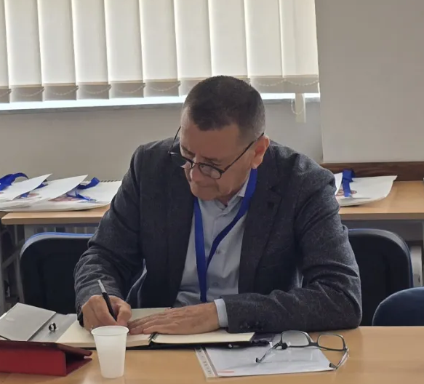
Interactive psychoanalysis
Interactive psychoanalysis, as a form of philosophical practise, whose founder is Milan Popov, has been developing for more than 20 years, grounded in the idea of interactivity, which in recent years has evolved from a mere hypotesis into a well established theoretical framework.
Prof. Milan Popov,
Philospher, founder of the Institute for philosophy and interdisciplinary studies

Slide 5

We as adults stand at the end of the developmental path by already thinking and concluding conceptually.
Interactivity remains a fundamental phenomenon whether the individual has taken notice of it or not, in other words, whether he is aware of the process or not.
How does the early mental development of a person begin, what is it that comes first?
The sensuality (what is perceived with our senses) that a newborn experiences is a rhapsody of shapes, colors, tones, smell and taste, each organ behaves autonomously as well as motor actions.
We can consider mental development a living process only when the synthesis of the senses begins, as well as the differentiation of objects from sensuality through intentionality.
Panksepp's basic emotional system of "search" is what we could call intentionality. The baby has only one interest in satisfying its biological need, since it does not have the ability to do it itself, the mother does it for it.
Provided that the child's biological needs are satisfied, mental development can begin with construction, i.e. with the separation of objects from sensuality. Identity in difference.

Slide 6
To achieve identity in difference, and this is possible by the process of differentiation taking place when the mother says and shows the child a "toy".
So, the mother puts a toy in the child's hands, the child instinctively grasps the toy, the mother pronounces the word "toy".
In play, the senses of sight, touch, and hearing are used; the child usually tries to eat the toy, and the senses of taste and smell are also at work, but the child also reproduces the mother's words.
What is important to understand is that the child does not draw a conclusion, nor is it aware that he has repeated the mother's word "toy" or that the toy in his hand is in connection with the spoken word. However, at some point, the mother says the word "toy" and the child begins to look for the toy in his environment. This is identity in difference, although "toy" is not a concept, but only a word, it is still something that refers to several objects in the environment that can be subsumed under the term "toy".
Sensuality is differentiated and the child distinguishes the toy from the floor on which it is, from himself and from his mother. The toy as a separate part of sensuality is clearly separated, has its own limits and shape.
The question arises whether a child makes a distinction between the word "toy" and a toy? The word "toy" is only a sensory component of what a toy represents. Ontogenetic development is still far from developed abstract thinking, it is necessary for the spoken word to become a concept.

Slide 7
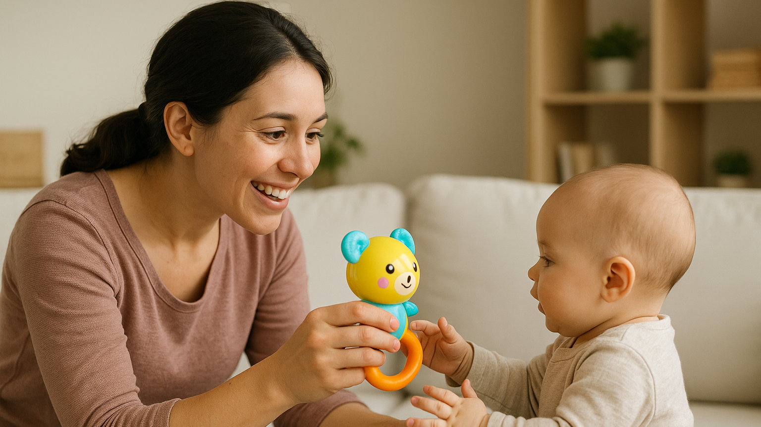
Interactivity is the relationship between abstract thinking and experiencing the environment. We have traveled this entire path from absolute identity (baby), all the way to identity in difference - a concept, so that we can now start going back on that path.
There are cases where a person with fully developed abstract thinking regresses to the rudiments of that abstraction, and that is the connection we have established between the word "toy" and the toy itself.
For the child, this relationship does not pose a problem at all because there is no clearly established continuity of time, no causal conclusions, nor does the concept of "toy" exist, there is only the sound characteristic of a toy. The child does not draw a conclusion!
However, for the analysand who has regressed, the situation becomes dramatic, on the one hand abstract thinking is preserved as well as logic, while on the other hand due to regression the analysand is not able to establish a clear temporal sequence, and therefore, neither cause nor effect are clearly separate categories and can be permuted
we call this process double manifestation.

Slide 8
As a product of this process, the analysand concludes and declares: “I predict the future, what I think happens” (representative thinking) or concludes and declares: “What I think about will happen” (predictive thinking). For the analysand, these are true statements that are not doubted.
The phone rings, it attracts attention and the person concludes that someone in the environment has a phone ringing. The analysand may conclude differently. The thought that the phone is ringing arose, and then the phone actually rang in the environment. Based on this, the analysand concludes that the thought of the phone ringing caused the phone to actually ring. So, this shows how representational thinking and reasoning work.
The mechanism of this process is enabled by regression, which leads to a double manifestation.
The interactive psychoanalyst is in the position of a phenomenologist who knows the mechanisms that make the analysand's situation dramatic, but the analysand has no knowledge of these mechanisms; he still feels that his abstract thinking is completely independent of sensuality and therefore absolutely believes in his conclusions, and therefore in their consequences, which always cause fear.
in order to be able to help analysands who often receive an F29 diagnosis based on the symptoms they exhibit; the interactive psychoanalyst must be able to consciously enter into regression, with the difference that he is aware of the process and mechanism and does not provoke fear of a new way of experiencing.
In our specialist training, analysts are introduced to this way of thinking through interactive workshops. The possibility of controlled regression is crucial for a good working alliance with the analysand, who can only gain insight in this way and rise from the position of a phenomenon to the position of a phenomenologist. When this happens, the analysand visibly stabilizes.

Slide 9

When the ego does not or can not connect thought with the external world, it simultaneously weakens its functions and is unable to resolve conflicts between instincts, moral imperatives and reality.
When thoughts are experienced separately from the self, then they exist independently and become rigid. Long-term fear, trauma, stress and anxiety can trigger specific thought patterns that lead to regression, which further leads to excessive abstraction and symbolic interpretations of everything the person experiences.
The goal is to find, through thought regression, the categorical concepts that stand behind the analysand's entire thought construction. Through this process of interaction, the analysand sees how his logical construction affects his relationship with the environment and his perception of reality.
The withdrawal of libido from external objects to oneself leads to narcissism, which is a core feature of schizophrenia. This withdrawal causes symptoms such as megalomania, hypochondria, and thought disorders.
Hallucinations and delusions are attempts to reestablish connections with the outside world.

Slide 10

In order to prove the hypothesis that interactivity is a fundamental human phenomenon, an experimental design is being developed.
The room in which the experiment would be conducted should be dark in color and without symbols in order to minimize associations with the space. The subjects would sit at a table at a 90-degree angle with a monitor (TV).
The subjects would be divided into two groups in which they would strive to be of similar age and equally represented by both sexes. One group would be broadcasted the content on the display while the other group would have the display turned off.
The content that would be broadcast is a red car moving along a road through the forest. It is important that the shots of the car are only from the outside, that it is constantly moving through a mountain landscape, and that the driver is not visible. In a conceptual sense, the recording could be a visual expression of the following group of concepts: red, car, movement, forest, mountain and travel. The respondents would not know at all what the goal of the experiment was; they would only have the task of solving a questionnaire, nor would they know whether the monitor was accidentally or intentionally left on or off. it is also very important to us that the respondents do not consciously connect the visual content with the questionnaire in any way.

Slide 11

questionnaire
The questionnaire would contain general and control questions and would be based on circling the offered answers.
The questions and answers would be analyzed semantically, morphologically, symbolically and associatively and as such placed in connection with the visual content.
The experiment aims to show the unconscious influence of the placed content on the choice of answers.
If the result were such that the influence was far greater in the group that had received the visual content, then it would experimentally prove interactivity.

Slide 12
Interactive psychoanalysis is a form of philosophical practice, addressing both therapeutic symptoms and the structure of thinking.
Its foundation lies in understanding the relationship between sensory perception and abstract thought.
It examines how concepts are built from a rhapsody of perceptions into meanings independent of immediate sensory experience.
Regression is not seen merely as pathology but as a philosophically significant event.
The method clarifies thought patterns where the boundary between internal representation and external reality becomes blurred.
In dual manifestation, thought and external reality interweave, leading to seemingly irrational but internally logical conclusions.
The analyst must abandon purely abstract rationality and adopt a regressive - interactive position alongside the analysand.
Regression is used not to get lost in chaos of perception and illogic, but to understand its mechanisms from within.

Slide 13
Unlike classical psychoanalysis, the interactive approach requires the analyst to consciously enter the phenomenological horizon of the event, abandoning the position of an external observer
Therapeutic work begins only after the analyst enters the analysand’s world—a genuine working alliance emerges through shared experience of dual manifestation.
Regression is not accidental but a defense mechanism against profound internal conflicts, triggering conscious and unconscious resistance
These states involve both primary gains (escape from reality) and secondary gains (shifts in family dynamics), complicating reintegration
It views human beings as entities in constant, conscious and unconscious exchange with their environment.
Therapy in interactive psychoanalysis focuses on connecting the concept (the word) and the environment, allowing the analysand to recognize how his thought patterns affect the perception of reality.
The analysand is in the world only when he reconnects with the world

